Slide 1
AIR QUALITY MONITORING

Slide 2
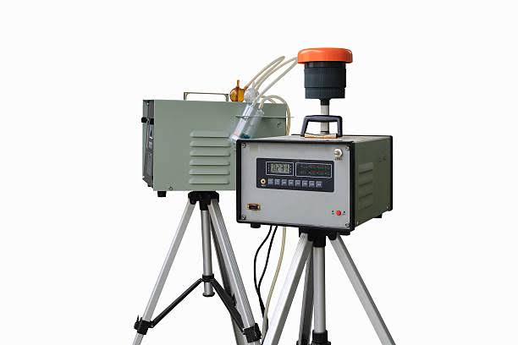
INTRODUCTION To provide adequate environmental and health protection, an effective air quality monitoring system is a necessary instrument. It is desirable that the system is simple, reliable, sensitive and cost-effective. In addition, this system must be highly sensitive to low concentrations of gaseous air contaminants such as hydrogen and carbon monoxide which exist in cigarette smoke. Typical environmental sampling methods for these contaminants employ manual grab samples that are collected on site and then transported to a laboratory for analysis. These sampling methods can be very costly and time consuming, and ongoing research has focused on the development of sensors that can replace traditional sampling methods to monitor contaminants in the environment

Slide 3
PROBLEMSTATEMENT An increase in traffic-related pollutant emissions. According to science, the six common air pollutants are particulate matter, ground-level zone, carbon monoxides, and lead. These are called the criteria pollutants and thus are required to be measured to tell us how healthy the air is breathe As opposed to a coarse-grained sensing system, a fine-grained approach would provide more frequent and spatially dense pollutant measurements. A scalable sensing platform could effectively disseminate pollution information to users in need. Several manufactures such as Auroral or Variable Technologies have recently introduced handheld pollution measurement devices. These devices are small enough to be carried by walking people for personal use and measure all the criteria pollutants.

Slide 4
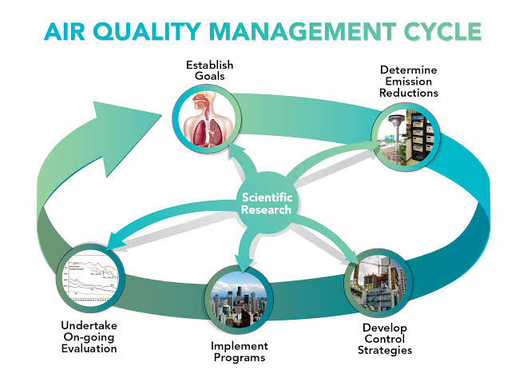
METHODOLOGY Sampler Methods These methods collect pollutant samples either by physical or chemical means for subsequent analysis in a laboratory. Typically, a known volume of air is pumped through a collector such as a filter or chemical solution for a known period of time, for subsequent laboratory analysis. The methodology utilizes a data base with real or simulated data from an air quality dispersion model for application with a two-step process for ascertaining the optimal monitoring network.

Slide 5
In the first step, the air quality patterns in the data base are collapsed into a single composite pattern through a figure-of-merit (FOM) concept. The most desirable locations are ranked and identified using the resultant FOM fields. The criteria can be set to provide coverage of less than some fixed, user-provided percentage of the coverage of the SOIs of the higher ranked stations and for some desired level of minimum detection capability of concentration fluctuations.

Slide 6
HARDWARE The hardware components include sensors, microcontrollers, and communication modules. The software components consist of a cloud platform, a mobile application, and a web-based dashboard. The IoT-based air pollution monitoring system provides several benefits over traditional air pollution monitoring systems. The IoT-based air pollution monitoring system provides several benefits over traditional air pollution monitoring.

Slide 7
PROBLEMSOLUTION Monitoring air is often associated with installing equipment that’s large, heavy and very expensive. However, the application of IoT (Internet of Things) technologies can provide a way to measure and report air quality with sensors that are more cost-efficient and provide more precise data than ever before. Specially configured sensors monitor ambient air for CO2, NOx and particulate matter. Decibel meters are installed to identify areas of the city that are dangerously polluted with noise. This stream of data is turned into a heat map showing varying degrees.

Slide 8
air quality. Over time, municipalities get a clear view of problematic areas, enforcing emission restrictions and optimizing infrastructure. Residents will breathe easier and the city will be at the forefront of quality-of-life innovation.

Slide 9

CONCLUSION Air quality monitoring systems are designed using different sensors for indoor and outdoor air quality monitoring in the previous works by using Bluetooth, GPS, GPRS wireless technologies. In a previous work WASP module is used which is costly. Instead of that different sensors can be used. The proposed system is developed for indoor air quality monitoring remotely. It is cost and energy efficient request and respond protocol is used along with combination of address and data centric protocols. Paper presents the summary of various techniques of air quality monitoring. These techniques are elaborately discussed in the paper. In the proposed system, one of the most preferred techniques is cloud based air quality monitoring system. Using the same cloud data, website is hosted and data is displayed on the website.

